Slide 1
Attacks and Malicious Software
Dr. zia ur rehman

Slide 2
Denial-of-Service Attack
A denial-of-service (DoS) attack is an attack designed to prevent a system or service from functioning normally.
Can exploit a known vulnerability in a specific application or operating system
Can attack features (or weaknesses) in specific protocols or services
Attempts to deny authorized users access either to specific information or to the computer system or network itself
Notes:
A denial-of-service (DoS) attack is an attack designed to prevent a system or service from functioning normally. A DoS attack can exploit a known vulnerability in a specific application or operating system, or it can attack features (or weaknesses) in specific protocols or services. In a DoS attack, the attacker attempts to deny authorized users access either to specific information or to the computer system or network itself. This can be accomplished by crashing the system—taking it offline—or by sending so many requests that the machine is overwhelmed.
The purpose of a DoS attack can be simply to prevent access to the target system, or the attack can be used in conjunction with other actions to gain unauthorized access to a computer or network. For example, a SYN flood attack can be used to prevent service to a system temporarily in order to take advantage of a trusted relationship that exists between that system and another.

Slide 3
Denial-of-Service Attack (continued)
A SYN flood attack can be used to prevent service to a system temporarily in order to take advantage of a trusted relationship that exists between that system and another.
Illustrates basic principles of most DoS attacks
Exploits weakness inherent to the TCP/IP protocol
Uses TCP three-way handshake to flood a system with faked connection requests

Slide 4
Denial-of-Service Attack (continued)
TCP three-way handshake
System 1 sends SYN packet to System 2.
System 2 responds with SYN/ACK packet.
System 1 sends ACK packet to System 2 and communications can then proceed.
Notes:
First, System 1 sends a SYN packet to System 2 indicating a desire to communicate with the system.
Then System 2 responds to System 1 by sending back the SYN packet combined with an ACK packet to indicate its willingness to accept communications.
Once System 1 receives the SYN/ACK packet, it responds with an ACK packet and communications are then established between the systems.

Slide 5
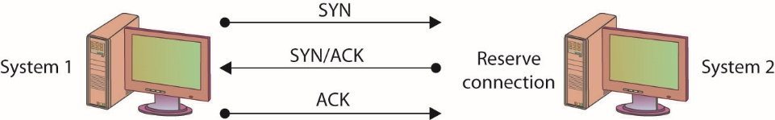
Figure 15.1 The TCP three-way handshake
Notes:
SYN flooding is an example of a DoS attack that takes advantage of the way TCP/IP networks were designed to function, and it can be used to illustrate the basic principles of any DoS attack. SYN flooding uses the TCP three-way handshake that establishes a connection between two systems. Under normal circumstances, the first system sends a SYN packet to the system with which it wants to communicate. The second system responds with a SYN/ACK if it is able to accept the request. When the initial system receives the SYN/ACK from the second system, it responds with an ACK packet, and communication can then proceed. This process is shown in Figure 15.1.

Slide 6
Denial-of-Service Attack (continued)
Steps of a SYN flood attack
Communication request sent to target system.
Target responds to faked IP address.
Target waits for non-existent system response.
Request eventually times out.
If the attacks outpace the requests timing-out, then systems resources will be exhausted.

Slide 7
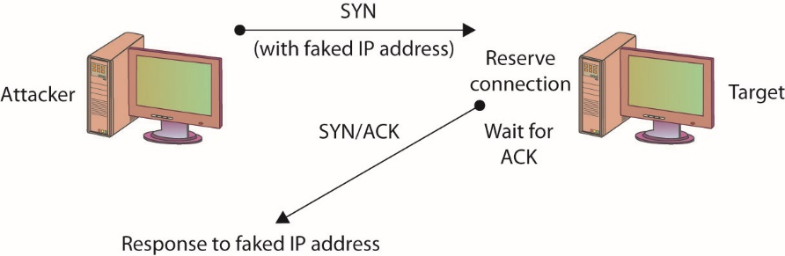
Figure 15.2 A SYN flooding–based DoS attack
Notes:
In a SYN flooding attack, the attacker sends fake communication requests to the targeted system. Each of these requests will be answered by the target system, which then waits for the third part of the handshake. Since the requests are fake (a nonexistent IP address is used in the requests, so the target system is responding to a system that doesn’t exist), the target will wait for responses that never come, as shown in Figure 15.2. The target system will drop these connections after a specific time-out period, but if the attacker sends requests faster than the time-out period eliminates them, the system will quickly be filled with requests. The number of connections a system can support is finite, so when more requests come in than can be processed, the system will soon be reserving all its connections for fake requests. At this point, any further requests are simply dropped (ignored), and legitimate users who want to connect to the target system will not be able to do so, because use of the system has been denied to them.

Slide 8
Denial-of-Service Attack (continued)
Another simple DoS attack is the infamous ping of death (POD).
POD targets a specific application or operating system.
Reminder: SYN flooding targets a protocol.
In the POD attack, the attacker sends an Internet Control Message Protocol (ICMP) ping packet equal to, or exceeding, 64KB.
Certain older systems are not able to handle this size of packet, and the system will hang or crash.

Slide 9
Denial-of-Service Attack (continued)
A DoS attack employing multiple attacking systems is known as a distributed denial-of-service (DDoS) attack.
Denies access or service to authorized users
Uses resources of many systems combined into an attack network
Overwhelms target system or network
With enough attack agents, even simple web traffic can quickly affect a large website
Notes:
Similar to a DoS attack, a Distributed Denial of Service (DDoS) attack has a goal of denying service to authorized users.
The difference between a DoS and DDoS attack centers on the ability of the DDoS to use the combined resources of many systems. An entire network of attack agents can be commandeered and controlled by an attacker.
The combined systems can then overwhelm the target with traffic under the direction of the attacker.
If the attack network is large enough, even simple web traffic can quickly overwhelm even the largest web sites.
A final option you should consider that will address several forms of DoS and DDoS attacks is to block ICMP packets at your border, since many attacks rely on ICMP. Blocking ICMP packets at the border devices prevents external ICMP packets from entering your network, and while this may block some functionality, it will leave internal ICMP functionality intact. It is also possible to block specific forms of ICMP; blocking Type 8, for instance, will block ICMP-based ping sweeps. It is worth noting that not all pings occur via ICMP; some tools, such as hping2, use TCP and UDP to carry ping messages.

Slide 10
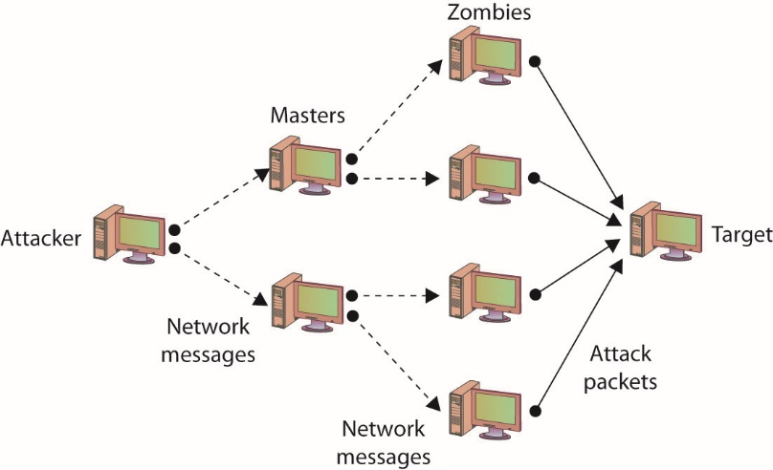
Figure 15.3 DDoS attack
Notes:
Figure 15.3 illustrates a DDoS network with agents and handlers.

Slide 11
Denial-of-Service Attack (continued)
Smurf attack
In a specific DoS attack known as a smurf attack, the attacker sends a spoofed packet to the broadcast address for a network, which distributes the packet to all systems on that network.
Further details are listed in the IP Address Spoofing section.

Slide 12
Denial-of-Service Attack (continued)
Defending against DOS-type attacks
Ensure you have applied the latest patches and upgrades to your systems and the applications running on them.
Change the time-out option for TCP connections so that attacks such as the SYN flooding attack are more difficult to perform.
For DDoS attacks, distribute your workload across several systems.
To prevent a DDoS attack, you must either be able to intercept or block the attack messages or keep the DDoS network from being established in the first place.

Slide 13
Denial-of-Service Attack (continued)
War-dialing is the term used to describe an attacker’s attempt to discover unprotected modem connections to computer systems and networks.
War-dialing was surprisingly successful, mostly because of rogue modems—unauthorized modems attached to computers on a network by authorized users.
War-driving is the unauthorized scanning for and connecting to wireless access points.
Frequently done while driving near a facility
Notes:
War-dialing is an attempt by an attacker to find unprotected modem connections to an organizations computer systems and networks.
Success is often the result of authorized individuals connecting unauthorized or rogue modems to the network. The authorized user’s intent is not usually malicious, but the results can be.
In recent years, advances in telephone firewalls have severely restricted unauthorized connections while also increasing the security of authorized modems as well.
The term war-driving refers to attackers wandering around an area (often in a car), searching for available wireless network connections. There are security measures built into both the hardware and software tasked with maintaining a wireless access point, but it will only operate as well as it is configured.

Slide 14
Social Engineering
Social engineering relies on lies and misrepresentation, which an attacker uses to trick an authorized user into providing information or access the attacker would not normally be entitled to.
Social engineering examples include:
Contacting a system administrator and pretending to be an authorized user, asking to have a password reset
Posing as a representative from a vendor who needs temporary access to perform some emergency maintenance
Notes:
The attacker might, for example, contact a system administrator and pretend to be an authorized user, asking to have a password reset. Another common ploy is to pose as a representative from a vendor who needs temporary access to perform some emergency maintenance. Social engineering also applies to physical access. Simple techniques include impersonating pizza or flower delivery personnel to gain physical access to a facility.
Attackers know that, due to poor security practices, if they can gain physical access to an office, the chances are good that, given a little unsupervised time, a user ID and password pair might be found on a notepad or sticky note.

Slide 15
Sniffing
Sniffing is when someone examines all the network traffic that passes their NIC, whether addressed for them or not.
A network sniffer is a software or hardware device.
The device can be used to view all traffic, or it can target a specific protocol, service, or even string of characters.
Sniffers may be able to modify some or all traffic in route
Network administrators can use a sniffer to monitor and troubleshoot network performance.
Notes:
The group of protocols that makes up the TCP/IP suite was designed to work in a friendly environment in which everybody who connected to the network used the protocols as they were designed. The abuse of this friendly assumption is illustrated by network-traffic sniffing programs, sometimes referred to as sniffers.
Sniffing occurs when someone examines all the network traffic that passes their NIC, whether addressed for them or not.
A network sniffer is a software or hardware device that is used to observe traffic as it passes through a network on shared broadcast media.
Sniffing can be used to view all traffic, or it can target a specific protocol, service, or even string of characters (looking for logins, for example).
Some network sniffers are designed not just to observe all traffic but to modify traffic as well.
Network sniffing is more difficult in switched network environments due to the way collision domains are eliminated in full-duplex switching, but certain techniques can be used (spanning ports, ARP poisoning, and attacks forcing a switch to fail and act as a hub) to circumvent this.
Network sniffers can be used by network administrators to monitor network performance.
Network sniffers can be used by attackers to gather information that can be used in penetration attempts.
For network sniffers to be most effective, they need to be on the internal network, which generally means that the chances for outsiders to use them against you are extremely limited.

Slide 16
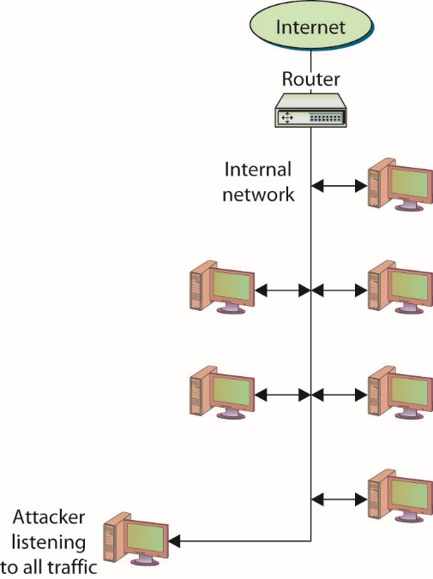
Sniffing
Figure 15.4 Network sniffers listen to all network traffic.
Notes:
Normally, the network device that connects a computer to a network is designed to ignore all traffic that is not destined for that computer.
Network sniffers ignore this friendly agreement and observe all traffic on the network, whether destined for that computer or others, as shown in Figure 15.4.

Slide 17
Spoofing
Spoofing is nothing more than making data look like it has come from a different source.
Spoofing is possible in TCP/IP because of the friendly assumptions behind the protocols.
Protocol assumed that individuals who had access to the network layer would be privileged users who could be trusted.
Notes:
Spoofing is nothing more than making data look like it has come from a different source. This is possible in TCP/IP because of the friendly assumptions behind the protocols. When the protocols were developed, it was assumed that individuals who had access to the network layer would be privileged users who could be trusted.
When a packet is sent from one system to another, it includes not only the destination IP address and port but the source IP address as well. You are supposed to fill in the source with your own address, but nothing stops you from filling in another system’s address. This is one of the several forms of spoofing

Slide 18
Spoofing (continued)
Spoofing e-mail
Occurs when a message is sent with a From address that differs from that of the sending system.
E-mail spoofing examples
Telnet to port 25 on a mail server – From there, you can fill in any address for the From and To sections of the message, whether or not the addresses are yours or even actually exist.
E-mail spoofing variation – Attackers acquire a URL similar to the URL they want to spoof so that e-mail sent from their system appears to have come from the official site.
Notes:
Spoofing E-Mail
In e-mail spoofing, a message is sent with a From address that differs from that of the sending system. This can be easily accomplished in several different ways using several programs.
Recipients can use several methods to determine whether an e-mail message was sent by the source it claims to have been sent from, but most users do not question their e-mail and will accept as authentic where it appears to have originated.

Slide 19
Spoofing (continued)
IP address spoofing
This occurs when a system inserts a different address in the From portion of the IP packet.
In a specific DoS attack known as a smurf attack, the attacker sends a spoofed packet to the broadcast address for a network, which distributes the packet to all systems on that network.

Slide 20
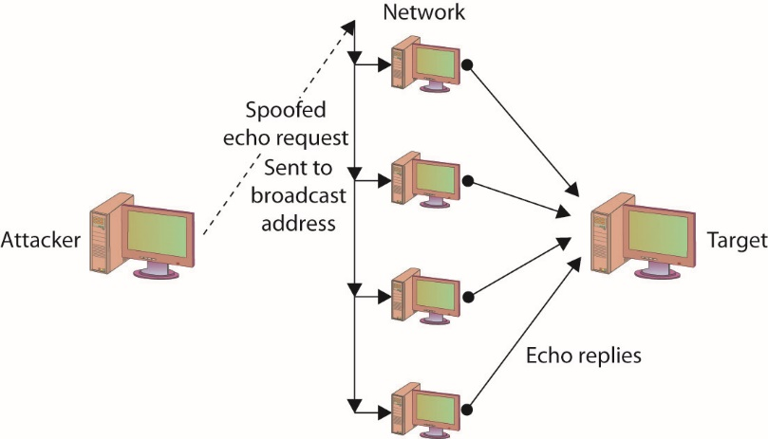
Figure 15.5 Smurfing used in a smurf DOS attack
Notes:
In the smurf attack, the packet sent by the attacker to the broadcast address is an echo request with the From address forged so that it appears that another system (the target system) has made the echo request. The normal response of a system to an echo request is an echo reply, and it is used in the ping utility to let a user know whether a remote system is reachable and is responding. In the smurf attack, the request is sent to all systems on the network, so all will respond with an echo reply to the target system, as shown in Figure 15.5. The attacker has sent one packet and has been able to generate as many as 254 responses aimed at the target. Should the attacker send several of these spoofed requests, or send them to several different networks, the target can quickly become overwhelmed.

Slide 21
Spoofing (continued)
Spoofing and trusted relationships
If two systems are configured to accept the authentication accomplished by each other, an individual logged onto one system might not be forced to go through an authentication process again to access the other system.
An attacker can take advantage of this arrangement by sending a packet to one system that appears to have come from a trusted system.
Since the trusted relationship is in place, the targeted system may perform the requested task without authentication.
Notes:
Spoofing can also take advantage of a trusted relationship between two systems. If two systems are configured to accept the authentication accomplished by each other, an individual logged onto one system might not be forced to go through an authentication process again to access the other system. An attacker can take advantage of this arrangement by sending a packet to one system that appears to have come from a trusted system. Since the trusted relationship is in place, the targeted system may perform the requested task without authentication.

Slide 22
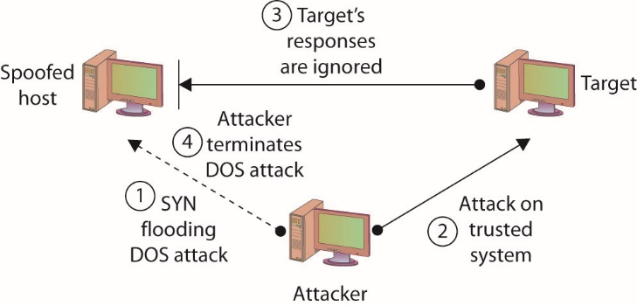
Figure 15.6 Spoofing to take advantage of a trusted relationship
Notes:
Figure 15.6 illustrates a spoofing attack that includes a SYN flooding attack.

Slide 23
Spoofing (continued)
Spoofing and sequence numbers
Formulating packets is more complicated for external attackers because of sequence number.
A sequence number is a 32-bit number established by the host that is incremented for each packet sent.
Packets are not guaranteed to be received in order; the sequence number can be used to help reorder packets.
The difference in the difficulty of attempting a spoofing attack from inside a network and from outside involves determining the sequence number.
Notes:
How complicated the spoofing is depends heavily on several factors, including whether the traffic is encrypted and where the attacker is located relative to the target. Spoofing attacks from inside a network, for example, are much easier to perform than attacks from outside of the network, because the inside attacker can observe the traffic to and from the target and can do a better job of formulating the necessary packets.
Formulating the packets is more complicated for external attackers because a sequence number is associated with TCP packets. A sequence number is a 32-bit number established by the host that is incremented for each packet sent. Packets are not guaranteed to be received in order, and the sequence number can be used to help reorder packets as they are received and to refer to packets that may have been lost in transmission.
The difference in the difficulty of attempting a spoofing attack from inside a network and from outside involves determining the sequence number.
If the attacker is inside of the network and can observe the traffic with which the target host responds, the attacker can easily see the sequence number the system creates and can respond with the correct sequence number.
If the attacker is external to the network and the sequence number the target system generates is not observed, it is next to impossible for the attacker to provide the final ACK with the correct sequence number. So the attacker has to guess what the sequence number might be.

Slide 24
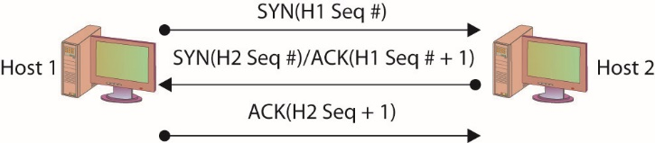
Figure 15.7 Three-way handshake with sequence numbers
Notes:
In the TCP three-way handshake, two sets of sequence numbers are created, as shown in Figure 15.7.
The first system chooses a sequence number to send with the original SYN packet. The system receiving this SYN packet acknowledges with a SYN/ACK. It sends an acknowledgment number back, which is based on the first sequence number plus one (that is, it increments the sequence number sent to it by one). It then also creates its own sequence number and sends that along with it. The original system receives the SYN/ACK with the new sequence number. It increments the sequence number by one and uses it as the acknowledgment number in the ACK packet with which it responds.

Slide 25
TCP/IP Hijacking
TCP/IP hijacking and session hijacking are terms used to refer to the process of taking control of an already existing session between a client and a server.
Attacker does not have to circumvent any authentication mechanisms.
Attack can be disguised with a DoS attack.
Hijack attacks generally are used against web and Telnet sessions.
Notes:
TCP/IP hijacking and session hijacking are terms used to refer to the process of taking control of an already existing session between a client and a server.
The advantage to an attacker of hijacking over attempting to penetrate a computer system or network is that the attacker doesn’t have to circumvent any authentication mechanisms, since the user has already authenticated and established the session.
To prevent the user from noticing anything unusual, the attacker can decide to attack the user’s system and perform a DoS attack on it, taking it down so that the user, and the system, will not notice the extra traffic that is taking place.
Hijack attacks generally are used against web and Telnet sessions. Sequence numbers as they apply to spoofing also apply to session hijacking, since the hijacker will need to provide the correct sequence number to continue the appropriated sessions.

Slide 26
Man-in-the-Middle Attacks
A man-in-the-middle attack generally occurs when attackers are able to place themselves in the middle of two other hosts that are communicating.
Attack is typically accomplished by compromising a router to alter the path of the traffic.
A common method of instantiating a man-in-the-middle attack is via session hijacking.
Session hijacking can occur when information such as a cookie is stolen, allowing the attacker to impersonate the legitimate session.
Can result from a cross-site scripting attack
Notes:
A man-in-the-middle attack generally occurs when attackers are able to place themselves in the middle of two other hosts that are communicating.
A man-in-the-middle attack can be accomplished by compromising a router to alter the path of the traffic.
The attacker can then observe all traffic before relaying it and can actually modify or block traffic.
To the target host, it appears that communication is occurring normally, since all expected replies are received.
There are numerous methods of instantiating a man-in-the-middle attack; one of the common methods is via session hijacking. Session hijacking can occur when information such as a cookie is stolen, allowing the attacker to impersonate the legitimate session. This attack can be as a result of a cross-site scripting attack, which tricks a user into executing code resulting in cookie theft. The amount of information that can be obtained in a man-in-the-middle attack will obviously be limited if the communication is encrypted. Even in this case, however, sensitive information can still be obtained, since knowing what communication is being conducted, and between which individuals, may, in fact, provide information that is valuable in certain circumstances.

Slide 27
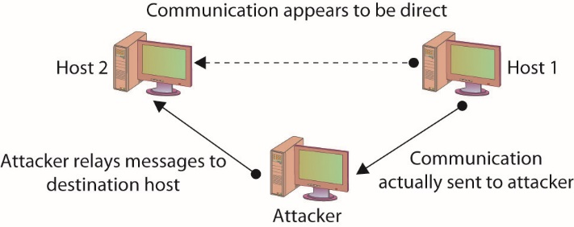
Figure 15.8 A man-in-the-middle attack
Notes:
A man-in-the-middle attack is ideally, accomplished by ensuring that all communication going to or from the target host is routed through the attacker’s host (which can be accomplished if the attacker can compromise the router for the target host). The attacker can then observe all traffic before relaying it and can actually modify or block traffic. To the target host, it appears that communication is occurring normally, since all expected replies are received. Figure 15.8 illustrates this type of attack.

Slide 28
Man-in-the-Middle Attacks (continued)
The term “man-in-the-middle attack” is sometimes used to refer to a more specific type of attack—one in which the encrypted traffic issue is addressed.
An attacker can conduct a man-in-the-middle attack by intercepting a request for a friend’s public key and the sending of your public key to him.
Well-designed cryptographic products use techniques such as mutual authentication to avoid this problem.

Slide 29
Replay Attack
A replay attack occurs when the attacker captures a portion of a communication between two parties and retransmits it at a later time.
Replay attacks are associated with attempts to circumvent authentication mechanisms.
The best way to prevent replay attacks is with encryption, cryptographic authentication, and time stamps.
Notes:
A replay attack occurs when the attacker captures a portion of a communication between two parties and retransmits it at a later time.
Generally replay attacks are associated with attempts to circumvent authentication mechanisms, such as the capturing and reuse of a certificate or ticket.
The best way to prevent replay attacks is with encryption, cryptographic authentication, and time stamps. If a portion of the certificate or ticket includes a date/time stamp or an expiration date/time, and this portion is also encrypted as part of the ticket or certificate, replaying it at a later time will prove useless, since it will be rejected as having expired.

Slide 30
Transitive Access
Transitive access is a means of attacking a system by violating the trust relationship between machines.
A simple example is when servers are well protected and clients are not, and the servers trust the clients.
In this case, attacking a client can provide transitive access to the servers.

Slide 31
Spam
Though not generally considered a social engineering issue, nor a security issue for that matter, spam can, however, be a security concern.
Spam is bulk unsolicited e-mail.
It can be legitimate in the sense that it has been sent by a company advertising a product or service.
Spam can also be malicious and could include an attachment that contains malicious software designed to harm your system, or a link to a malicious web site that may attempt to obtain personal information from you.
Notes:
Though not generally considered a social engineering issue, nor a security issue for that matter, spam can, however, be a security concern. Spam, as just about everybody knows, is bulk unsolicited e-mail. It can be legitimate in the sense that it has been sent by a company advertising a product or service, but it can also be malicious and could include an attachment that contains malicious software designed to harm your system, or a link to a malicious web site that may attempt to obtain personal information from you.

Slide 32
Spim
Though not as well known, a variation on spam is spim, which is basically spam delivered via an instant messaging application such as Yahoo! Messenger or AOL Instant Messenger (AIM).
The purpose of hostile spim is the same as that of spam—the delivery of malicious content or links.

Slide 33
Phishing
Phishing is the use of fraudulent e-mails or instant messages that appear to be genuine but are designed to trick users.
The goal of a phishing attack is to obtain from the user information that can be used in an attack, such as login credentials or other critical information.

Slide 34
Spear Phishing
Spear phishing is the term that has been created to refer to a phishing attack that targets a specific group with something in common.
By targeting a specific group, the ratio of successful attacks (that is, the number of responses received) to the total number of e-mails or messages sent usually increases because a targeted attack will seem more plausible than a message sent to users randomly.

Slide 35
Vishing
Vishing is a variation of phishing that uses voice communication technology to obtain the information the attacker is seeking.
Vishing takes advantage of the trust that some people place in the telephone network.
Users are unaware that attackers can spoof (simulate) calls from legitimate entities using voice over IP (VoIP) technology.
Voice messaging can also be compromised and used in these attempts.
Attackers seek to obtain information for identity theft.
Notes:
Generally, the attackers are hoping to obtain credit card numbers or other information that can be used in identity theft. The user may receive an e-mail asking him or her to call a number that is answered by a potentially compromised voice message system. Users may also receive a recorded message that appears to come from a legitimate entity. In both cases, the user will be encouraged to respond quickly and provide the sensitive information so that access to their account is not blocked. If a user ever receives a message that claims to be from a reputable entity and asks for sensitive information, the user should not provide it but instead should use the Internet or examine a legitimate account statement to find a phone number that can be used to contact the entity. The user can then verify that the message received was legitimate or report the vishing attempt.

Slide 36
Pharming
Pharming consists of misdirecting users to fake web sites that have been made to look official.
Users directed to the fake web site as a result of activity such as DNS poisoning or modification of local host.
Once at the fake web site, the user may supply personal information, believing that they are connected to the legitimate site.

Slide 37
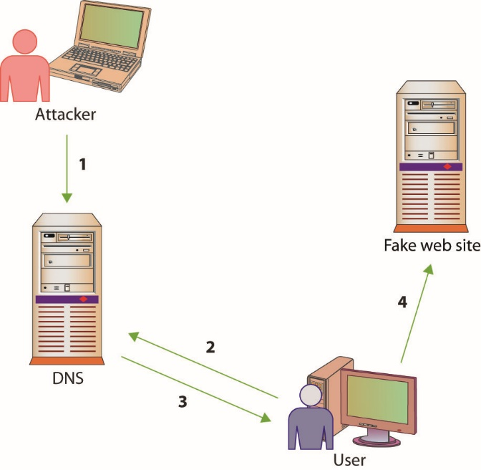
Figure 15.9 How pharming works
Notes:
Figure 15.9 illustrates how pharming operates. The first step is an attacker poisons the DNS system, so when the user queries it (step 2) they get a false address (step 3). This results in the user being directed to the fake web site (step 4).

Slide 38
Scanning Attacks
Scanners can be used to send specifically crafted packets in an attempt to determine TCP/UDP port status.
An XMAS scan uses the URG, PSH, and FIN flags to determine TCP port availability.
If the port is closed, an RST is returned.
If the port is open, there is typically no return.
Advanced firewalls can detect these packets, alerting people to the scanning activities.
Notes:
An XMAS scan can help determine OS type and version, based upon TCP/IP stack responses, and can also help determine firewall rules. These attacks can also be used to consume system resources, resulting in DoS.
Simple stateless firewalls check for the SYN flag set to prevent SYN floods, and Christmas packets are designed not to have SYN set, so they pass right by these devices.

Slide 39
Attacks on Encryption
Encryption is the process of transforming plaintext into an unreadable format known as ciphertext using a specific technique or algorithm.
Most encryption techniques use some form of key in the encryption process.
Cryptanalysis is the process of attempting to break a cryptographic system—it is an attack on the specific method used to encrypt the plaintext.
Cryptographic systems can be compromised in various ways.

Slide 40
Attacks on Encryption (continued)
Certain encryption algorithms may have specific keys that yield poor, or easily decrypted, ciphertext.
An exhaustive search of the keyspace will decrypt the message.
The strength of the encryption method is related to the sheer size of the keyspace.
You cannot immediately compare different key lengths from different algorithms and assume relative strength.

Slide 41
Attacks on Encryption (continued)
One of the most common ways of attacking an encryption system is to find weaknesses in mechanisms surrounding the cryptography.
It is not the cryptographic algorithm itself that is being attacked, but rather the implementation of that algorithm in the real world.

Slide 42
Address System Attacks
IP addresses and other addresses can be manipulated.
DNS kiting, is an economic attack against the terms of using a new DNS entry.
Another twist on this scheme is the concept of domain name front running, where a registrar places a name on a five-day hold after someone searches for it, and then offers it for sale at a higher price.
Notes:
Exam Tip: The process of using a new domain name for the five-day “test” period and then relinquishing the name, only to repeat the process again—in essence, obtaining a domain name for free—is called DNS kiting.

Slide 43
Cache Poisoning
Caches can also be poisoned, sending incorrect information to the end user’s application, redirecting traffic, and changing system behaviors.

Slide 44
Cache Poisoning (continued)
A DNS poisoning attack occurs when network connections are changed, resulting in different DNS lookups.
DNS poisoning can occur at any level.
At times, nslookup will return a nonauthoritative answer.
DNS poisoning is a variant of a larger attack class referred to as DNS spoofing, in which an attacker changes a DNS record through any of a multitude of means.

Slide 45
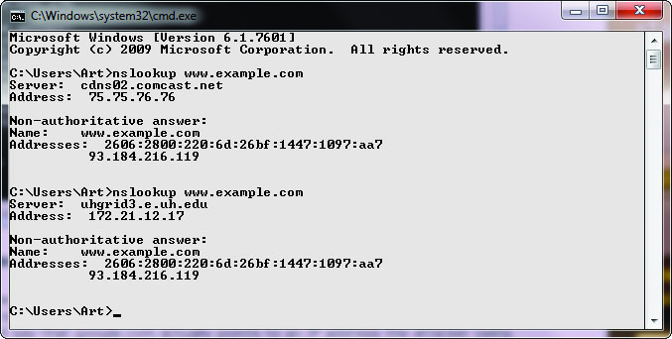
Figure 15.10 nslookup of a DNS query
Notes:
Figure 15.10 shows a series of DNS queries executed on a Windows machine. In the first request, the DNS server was with an ISP, while on the second request, the DNS server was from a VPN connection. Between the two requests, the network connections were changed, resulting in different DNS lookups. This is a form of DNS poisoning attack.

Slide 46
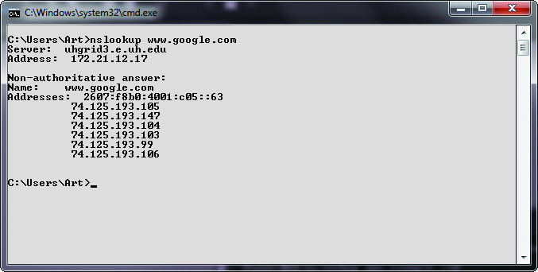
Figure 15.11 Cache response to a DNS query
Notes:
At times, nslookup will return a nonauthoritative answer, as shown in Figure 15.11. This typically means the result is from a cache as opposed to a server that has an authoritative (that is, known to be current) answer.

Slide 47
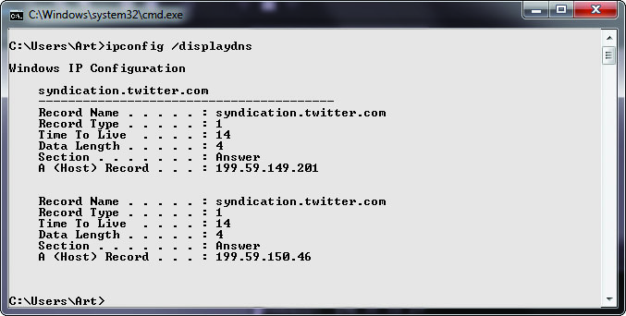
Figure 15.12 Cache response to a DNS table query
Notes:
There are other commands you can use to examine and manipulate the DNS cache on a system. In Windows, the ipconfig/displaydns command will show the current DNS cache on a machine.
Figure 15.12 shows a small DNS cache. This cache was recently emptied using the ipconfig /flushdns command to make it fit on the screen.

Slide 48
Cache Poisoning (continued)
ARP poisoning involves an attacker sending messages, corrupting the ARP table, and causing packets to be misrouted.
This form of attack results in malicious address redirection.
This can allow a mechanism whereby an attacker can inject themselves into the middle of a conversation between two machines, a man-in-the-middle attack.
Local MAC addresses can also be poisoned in the same manner, although it is called ARP poisoning.

Slide 49
Password Guessing
The most common form of authentication is the user ID and password combination
While it is not inherently a poor mechanism for authentication, the combination can be attacked in several ways.
All too often, these attacks yield favorable results for the attacker not as a result of a weakness in the scheme but usually due to the user not following good password procedures.

Slide 50
Password Guessing (continued)
People are notorious for picking poor passwords.
Users need to select a password that they can remember, so they create simple passwords.
The attacker just needs to obtain a valid user ID and some information about the user before guessing can begin.
A password-cracking program can uses a list of dictionary words to try to guess the password.
Rules can also be defined so that the cracking program will substitute special characters for other characters or combine words.

Slide 51
Password Guessing (continued)
In a brute-force attack, a password-cracking program attempts all possible character combinations.
There are two levels of brute-force attack:
Use a password-cracking program to attempt to guess the password directly at a login prompt
Steal a password file and use a password-cracking program to compile a list of possible passwords based on the list of password hashes contained in the password file (offline)
Use narrower list to attempt to guess the password at the login prompt
Notes:
A brute-force attack on a password can take place at two levels:
The attacker can use a password-cracking program to attempt to guess the password directly at a login prompt. The attack can be made more difficult if the account locks after a few failed login attempts.
The attacker can first steal a password file, use a password-cracking program to compile a list of possible passwords based on the list of password hashes contained in the password file (offline), and then use that narrower list to attempt to guess the password at the login prompt. The second attack can be thwarted if the password file is securely maintained so that others cannot obtain a copy of it.

Slide 52
Password Guessing (continued)
A hybrid password attack is an attack that combines the preceding dictionary and brute-force methods.
The birthday attack is a special type of brute-force attack
Uses the birthday paradox that states that in a group of at least 23 people, the chance that two individuals will have the same birthday is greater than 50 percent.
Mathematically, the equation is 1.25×k^{1/2}, where k equals the size of the set of possible values, which in the birthday paradox is 365
Notes:
The birthday attack phenomenon applies to passwords, with k (number of passwords) being quite a bit larger.

Slide 53
Pass-the-Hash Attacks
Pass the hash is a hacking technique where the attacker captures the hash used to authenticate a process.
The attacker can then use this hash by injecting it into a process in place of the password.
This is a highly technical attack, targeting the Windows authentication process, injecting a copy of the password hash directly into the system.
The attacker does not need to know the password.
Notes:
The attacker does not need to know the password, but instead can use a captured hash and inject it directly, which will verify correctly, granting access. As this is a very technically specific hack, tools have been developed to facilitate its operation.

Slide 54
Software Exploitation
Software exploitation is an attack that takes advantage of bugs or weaknesses in software.
Can be the result of poor design, poor testing, or poor coding practices
Can result from what are sometimes called “features”
A preventable problem
Fuzzing: the automated process of applying large sets of inputs to a system and analyzing the output to determine exploitable weaknesses
Can exploit error messages from applications

Slide 55
Software Exploitation (continued)
A common weakness that has often been exploited is a buffer overflow, which occurs when a program is provided more data for input than it was designed to handle.
An integer overflow is a programming error condition that occurs when a program attempts to store a numeric value, an integer, in a variable that is too small to hold it.

